Slide 1
OPENSEARCHCON 2026 · OPERATIONS & OBSERVABILITY · 30 MIN
FROM
TO
ALERT
ANSWER
→
Accelerating Anomaly Investigation with OpenSearch Agent Skills
The detector finds the signal. This talk is about what happens next.
Notes:
Quick show of hands — who's been paged in the last thirty days? [wait for hands]
Keep it up if the very first thing you did was open a dashboard and start guessing.
[hands stay up] [beat] Look around. That's the talk. Every one of those hands is twenty minutes of an engineer manually doing something a machine already had the data to do.
So let’s talk about what happens after an anomaly detector fires.
Detection is largely a solved problem. The hard part — the expensive part — is what comes next. This talk is about using OpenSearch agent skills to collapse that investigation window from 20 minutes to seconds.
We built a full working implementation — the agent, the alerting loop, the custom tools — and we'll walk through the architecture, the design decisions, and the failure modes that will humble you in production.

Slide 2
THE PROBLEM
Detection lag is solved.
Investigation lag isn't.
~20 min
The anomaly detector fires in milliseconds. The SRE then spends 20 minutes correlating logs, cross-referencing metrics, and scanning deploy history before knowing where to look.
That gap is the problem.
average time from alert to hypothesis
for an on-call SRE
Notes:
Here's the number that should bother you: 20 minutes.
That's the average time from "alert fired" to "I know where to look." And this is not time spent fixing the problem — this is just forming a hypothesis. Correlating logs manually, scanning metrics, checking deploy history.
Every minute of that is pure toil. And it compounds at scale — multiple on-calls, multiple incidents per week, every engineer who gets paged at 2AM and has to reconstruct context from scratch.
The anomaly detector did its job. The investigation gap is where we lose.

Slide 3
THE GAP
What happens between the alert and the action.
02:14:32
Anomaly detected — grade: 0.89 · feature: p99_latency_ms · service: payment-service
02:15:00
SRE paged, opens dashboard
02:17
Checks anomaly results, confirms spike is real
02:20
Correlates error logs in prod-logs index (manual Discover query)
02:26
Checks deploy-events for recent changes
02:31
Identifies log pattern: "database connection pool exhausted"
02:34
Forms hypothesis, takes action — 20 minutes after detection
Notes:
Let's make this concrete. It's 2:14 AM. The anomaly detector fires — it does its job in milliseconds.
But look at what the on-call SRE has to do manually over the next 20 minutes. Each of these steps is a separate query, a separate context switch, a separate tab. "Checks anomaly results" — that's one query. "Correlates error logs" — that's a Discover query against prod-logs. "Checks deploy-events" — that's another index, another filter.
This is the investigation gap. It's not a technology problem — OpenSearch has the data. It's a workflow problem. No one is orchestrating these steps automatically.

Slide 4
WHAT YOU HAVE
OpenSearch knows there's a problem.
WHAT THE DETECTOR RETURNS
WHAT IT DOESN'T TELL YOU
✓ Anomaly score: 0.89
– Root cause
✓ Timestamp: 02:14:32 UTC
– Which component failed
✓ Feature: p99_latency_ms
– What changed recently
✓ Confidence: HIGH
– Correlated error patterns
✓ Grade threshold: > 0.7
– Recommended action
Notes:
OpenSearch's anomaly detection plugin is genuinely good at what it does. It gives you a score, a timestamp, the affected feature, and a confidence grade.
But it stops there. Look at the right column — root cause, which component, what changed, correlated patterns, recommended action. All of that is still on the SRE.
The detector is not wrong to stop here. Surfacing the signal is its job. What we're building is what comes after the signal — the investigation layer that the ML plugin doesn't provide.

Slide 5
THE SOLUTION
Connect detection to investigation.
anomaly_detector
grade > 0.7
alerting_monitor
webhook
flow_agent
tools →
ranked report
TOOLS IN THE FLOW
SearchAnomalyResultsTool
confirm the anomaly is real
SearchIndexTool (prod-logs)
correlate error log spikes
SearchIndexTool (deploy-events)
identify recent deployments
LogPatternTool
cluster repeated log patterns
MLModelTool
No humans in the loop until the report is ready!
synthesise ranked hypotheses from tool output
Notes:
The fix is to wire these three existing layers together. The anomaly detector already exists. The alerting monitor already exists. What we're adding is the flow agent — which picks up where the detector left off.
The agent runs five tools in sequence: it confirms the anomaly is real, queries error logs in the same window, checks for recent deploys, clusters repeated log patterns, then hands everything to the LLM to synthesise a report.
No human in the loop until the report is ready. The SRE wakes up to a hypothesis, not a dashboard.
The flow agent type in OpenSearch ML Commons is the right primitive here — it's deterministic, sequential, and the tool outputs chain together naturally.

Slide 6
TOOL DESIGN
Useful agents ask small, bounded questions.
01
Deterministic before generative
Search tools run first. LLM synthesises last. Never let the model search.
02
One question per tool
Each tool answers exactly one thing. Overlap creates hallucinated confidence.
03
Fail fast and transparently
An empty result is information. A hallucinated one is a pager storm waiting to happen.
04
Time-bound every query to the anomaly window
now-10m is not a guess — it's the anomaly detection window. Use it or get noise.
Notes:
Here's where most agent implementations go wrong: they give the model too much power and wonder why it hallucinates.
Principle 1 — Deterministic before generative. Search tools run first. The LLM only sees the output of structured queries. It never decides what to search for. That's the single most important design decision.
Principle 2 — One question per tool. SearchAnomalyResultsTool answers "did an anomaly happen?" Nothing else. Tools that answer multiple questions conflate their results and make synthesis harder.
Principle 3 — Fail loudly. An empty result set is useful information. A hallucinated "no errors found" is dangerous.
Principle 4 — Time windows matter. The anomaly window is your search window. "now-10m" when the anomaly happened 45 minutes ago is a silent bug that produces garbage output.

Slide 7
IN PRACTICE
02:14 AM. Agent triggered.
02:14:32 ALERT anomaly grade 0.89 · feature p99_latency_ms · service payment-service
02:14:33 AGENT flow agent triggered via webhook
02:14:33 ▸ SearchAnomalyResultsTool querying prod-metrics … 47ms
02:14:33 ▸ SearchIndexTool (prod-logs) now-10m, ERROR/WARN … 112ms
02:14:33 ▸ SearchIndexTool (deploys) now-60m … 89ms
02:14:34 ▸ LogPatternTool clustering 847 log lines … 203ms
02:14:34 ▸ MLModelTool synthesising … 1.2s
02:14:35 REPORT HIGH CONFIDENCE — deploy-induced regression
payment-service v2.4.1 → v2.4.2 deployed 02:08 UTC
pattern: "database connection pool exhausted" (62% of errors)
recommendation: rollback or increase pool size (max_conn: 20 → 100)
Notes:
Here's the demo moment. Alert fires at 02:14:32. The webhook triggers the agent. Five tools run in under 2 seconds total.
Notice the timing: SearchAnomalyResultsTool in 47ms, log query in 112ms, deploys in 89ms, log pattern clustering in 203ms, LLM synthesis in 1.2s. Total elapsed: about 1.7 seconds.
The report identifies: payment-service, a deploy from 02:08 UTC (6 minutes before the anomaly), a connection pool exhaustion pattern in 62% of error logs, and a specific remediation.
That's what the SRE would have spent 20 minutes piecing together manually. The agent did it before the pager was acknowledged.
[PAUSE — let the audience read the terminal output]

Slide 8
PRODUCTION REALITY
The things that will humble you.
LLM synthesis is the weakest link
Tools hallucinate less than models do. Every token the model adds is a liability.
Wide tool access → confident wrong answers
More data is not always more signal. Unrelated indices produce false correlations.
Alert fatigue transfers to agent fatigue
If the anomaly detector fires constantly, so does the agent. Tune detection first.
Index naming can fail silently
prod-logs ≠ production-logs — the agent doesn't know and won't warn you.
Time windows drift
now-10m is wrong when the anomaly happened 45 minutes ago. Match window to detector interval.
Notes:
Now the honest part. These are the failure modes we actually hit.
1. LLM synthesis is the weakest link. Every tool output we feed the model is an opportunity for hallucination. We fixed this by keeping the synthesis prompt narrow: "here is structured data, summarise it." Not "investigate."
2. Wide tool access makes agents confidently wrong. When we gave the agent access to 8 indices instead of 3, it started finding correlations that weren't there. Scope is a feature.
3. Alert fatigue transfers. If the anomaly detector fires 50 times a day, so does the agent. Tune your detector's grade threshold first — we use 0.7 as a minimum.
4. Index naming is a silent footgun. prod-logs and production-logs are different indices. The agent doesn't warn you.
5. Time windows drift. If the anomaly happened 45 minutes ago but the agent queries now-10m, it finds nothing and says so. Match your query window to the detection interval.

Slide 9
HONEST ASSESSMENT
Where human judgment still wins.
SCENARIO
WHY THE AGENT FALLS SHORT
Novel failure modes
The agent has never seen this pattern. Pattern matching fails on first-time failures.
Blast radius decisions
"Is it safe to rollback right now?" requires knowing what else is deployed.
Rollback authorisation
Someone still has to say yes. The agent surfaces the hypothesis; the human owns the action.
Cross-team coordination
Slack, stakeholder communication, and escalation are not agent output.
Context the logs don't hold
"We pushed this exact fix last quarter." That knowledge lives in people, not indices.
Notes:
The agent compresses the investigation window. It does not own the decision. That boundary matters.
Novel failure modes: the agent pattern-matches against what it's seen before. A completely new failure class — one with no log precedent, no matching deploy — needs a human who can say "I've never seen this either."
Blast radius decisions require context the agent doesn't have: what else is deployed in this region, what other teams depend on this service, whether a rollback would cascade.
Rollback authorisation: someone still has to say yes. The agent surfaces the hypothesis; the human owns the action.
Cross-team coordination: the report lands in Slack because a human sends it.
Context the logs don't hold: "we pushed this exact fix last quarter and it broke things differently" — that knowledge lives in people, not indices. Don't pretend the agent can replace it.

Slide 10
DEMO TIME!

Slide 11
TAKEAWAY
Three layers. One wire.
anomaly_detector
Measure dwell time
before and after.
↓ grade > 0.7
alerting_monitor
↓ fires webhook
That's your before-and-after.
flow_agent
↓ runs tools
├─ SearchAnomalyResultsTool
├─ SearchIndexTool (prod-logs)
Wire detector → monitor → agent once
├─ SearchIndexTool (deploy-events)
Scope each tool to one bounded query
├─ LogPatternTool
└─ MLModelTool
Ship first; measure dwell time as your KPI
↓ synthesise
ranked_hypotheses
Tune detection before adding more tools
Notes:
Here's the leave-behind pattern. Three layers you probably already have: anomaly detector, alerting monitor, and now a flow agent.
The webhook is the wire. The tools are the investigation. The MLModelTool synthesis is the last step — not the first.
Start with two tools, not five. Get SearchAnomalyResultsTool and SearchIndexTool working first. Measure dwell time — the time from alert fired to action taken — before and after. That's your before-and-after.
Add tools based on what the reports get wrong, not based on what you think might help. Every tool you add is another surface for hallucination in synthesis.
Ship it. Measure it. Tune it. The pattern scales.

Slide 12
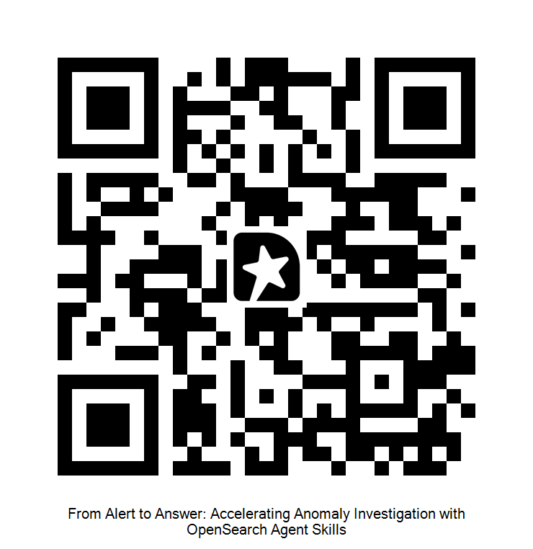
THANK YOU
FROM
TO
ALERT
ANSWER
→
The agent is in the repo.
The alerting loop is wired up.
The failure modes are real.
Questions welcome — especially the ones about production.
Notes:
The full implementation is in the repo: github.com/seema1711/opensearch-skills
The agent is wired up. The alerting loop is running. The failure modes I described are all from real debugging — they're not hypothetical.
If you're running OpenSearch 2.12 or later, you have everything you need to wire this today: ML Commons flow agents, the anomaly detection plugin, and the alerting framework are all GA.
Happy to take questions — especially the hard ones about production edge cases, LLM prompt tuning for on-call contexts, or how to handle detectors that fire constantly.

Slide 13

Resources and contacts
Slides, demos, and additional resources
PRESENTERS
RESOURCE PACK
ALL LINKS IN ONE PLACE
Seema Saharan
Slides
Autodesk
PDF
Demo repository
/in/seemasaharan/
Code, configs, and data
Brian Graf
Instaclustr Free Trial
https://ntap.fyi/free
NetApp Instaclustr
/in/TheBrianGraf
ntap.fyi/oscna2026
12 / 12
Notes:
Closing resource slide. Leave visible during final questions and as people leave.
The Advanced RAG course includes the narration and hands-on labs behind these demonstrations.
Before presenting: replace bracketed contact fields, confirm the second presenter, and replace the placeholder QR image and short link with the final resource landing page. The supplied QR is a placeholder, not a verified resource destination.
Resource pack: slides (PDF and editable deck), demo repository (code, configs, data), Advanced RAG course (narration and labs), follow-up documentation and contact links.
Course repository referenced in this deck: https://github.com/instaclustr/InstAcademy

